Slide 1

E-WASTE FACILITY LOCATOR
CODERS UNITED

Slide 2
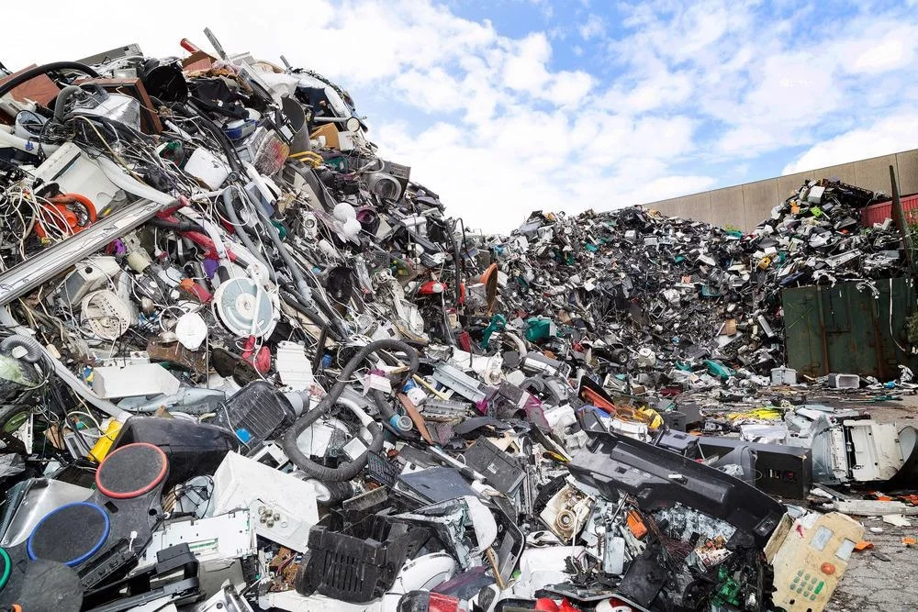
THE E-WASTE EPIDEMIC
Environmental Impact
Resource Recovery
Health Risk
Legislation and Responsible Disposal
India is a 3rd largest E-Waste producer
There are only 519 E-Waste facility

Slide 3
OUR INNOVATIVE SOLUTION
E- Waste Collection and Recycling Locator : A user friendly platform to help individuals locate nearby e-waste collection and recycling facilities , promoting responsible disposal.
Know Our Product(Estimating Value): Users can input details about their old electronic devices ,and the platform calculates the estimated value of recoverable materials, providing an incentive for recycling.
Credit Score and Incentives :Users earn credit points based on the estimated value of their e-waste, which can be redeemed for discounts, donations ,or cashback incentives.
Emphasis on Responsible E-Waste Disposal : Educational content informs users about the harmful components of e-waste and its impact on the environment and health, raising awareness.

Slide 4
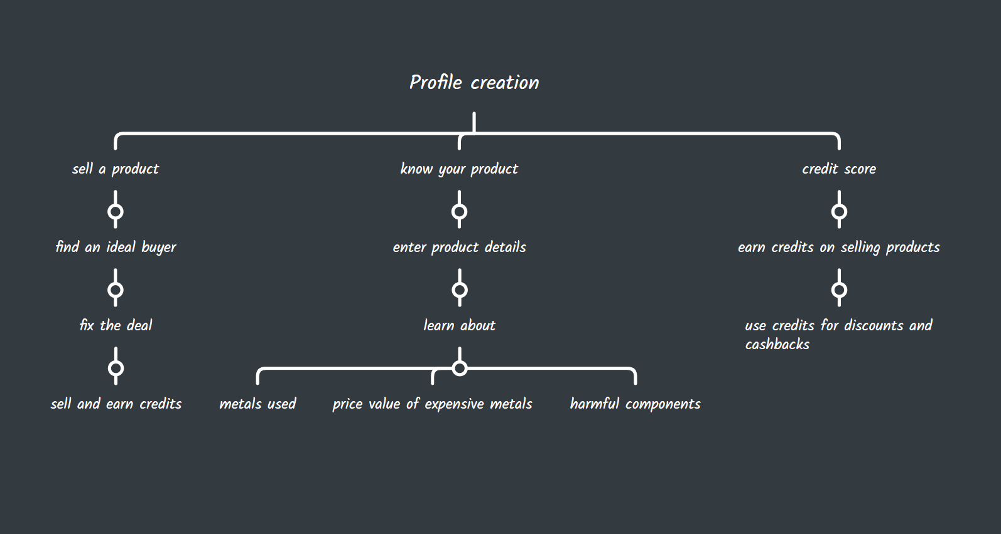

Slide 5






TECH BEHIND THE SOLUTION

Slide 6
E–WASTE AWARENESS
.
1.Token Incentive: Participants receive tokens for every piece of e-waste they recycle, which can be redeemed for various rewards.
2.Certificates of Achievement: Participants are awarded certificates recognizing their eco-friendly efforts, fostering a sense of accomplishment.
3.Incentivizing Recycling: Tokens can be exchanged for a range of goodies, encouraging more people to recycle their electronic devices.
4.Community Engagement: The program fosters a sense of community as individuals work together to protect the environment.
5.Long-term Impact: The initiative ultimately contributes to a greener future by encouraging responsible e-waste disposal and promoting sustainable consumption practices.

Slide 7
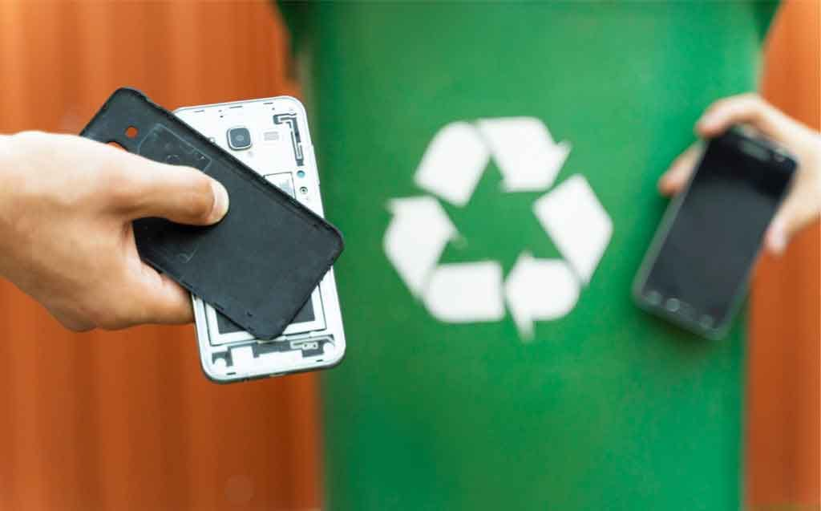
CONCLUSION
Environmental Impact
Financial Incentives
Challenges Acknowledged
Dependence on Technology

Slide 8


